Slide 1
Black Diamond Quick Start Guide
Gain Access To Your Personal Financial Portal Today

Slide 2
1
v
AM
Annex Wealth Management <noreply@bdreporting.com> To: John Smith
You will receive a “New User Setup” email similar to the example shown here.
This email will come “from” our firm and a “no reply” email address of noreply@bdreporting.com.
Included in this email is a link to set up your account. Please click on the “Set Up Account” button or, copy and past the full URL into your browser.
For security purposes, your set up link will expire after 7 calendar days.
Should the link expire, please contact your Client Service Manager and they will be happy to resend the email with a new set up link.
Dear John,
Welcome to Black Diamond! With Black Diamond, you’ll be able to access a variety of investment account information, review your quarterly performance reports, and see detailed information about your allocations and activity all in one place. We’ve created a new username for you to be able to access your portfolio and accounts at any time. Please make note of your username and password for future access to your information.
Your username: jsmith123
Please click on the following to set up your account:
Set Up Account

Slide 3
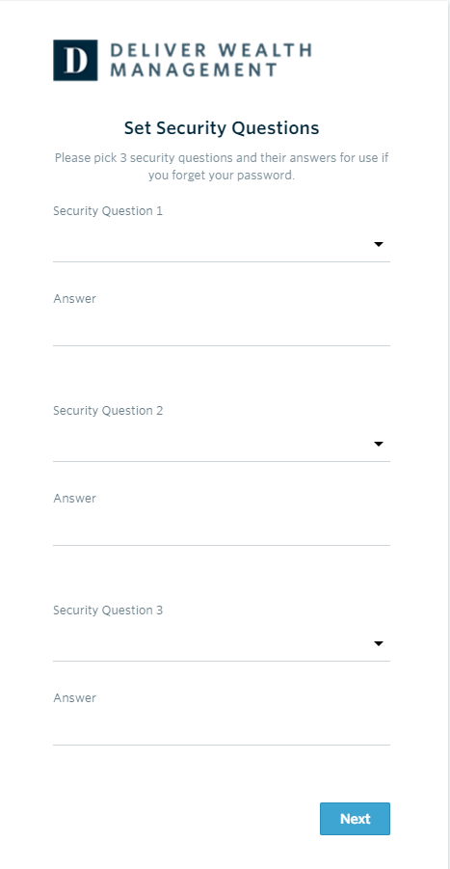
2
Upon clicking the link within the email (or copying and pasting it into your browser), you will be prompted to set security questions.
It is required you choose a security question from the preexisting lists and set up all three questions.
To continue, click “Next.”

Slide 4
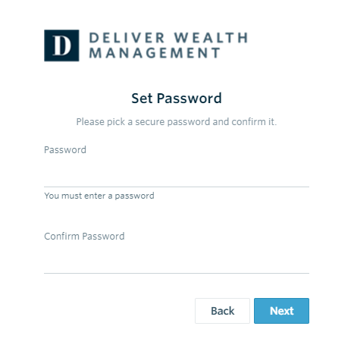
3
Next you will need to set a secure password. Please enter a chosen password in the first form field. Then re-type your password in the second form field under “Confirm Password.”
If your password meets security requirements and matches between the two form fields, you may then click “Next.”

Slide 5
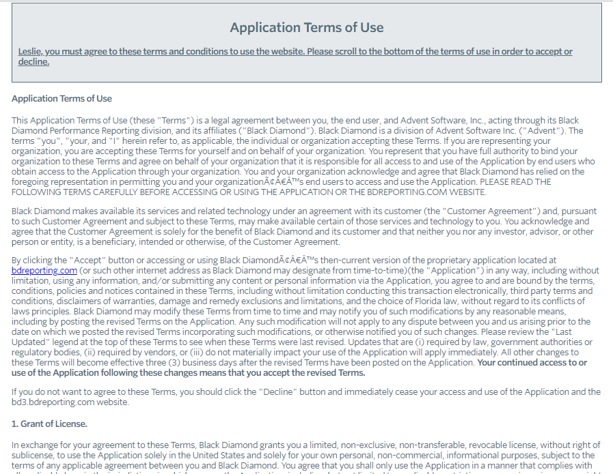
4
The final step is to read through and accept the “Application Terms of Use.”
After accepting, you will be automatically directed to your personalized client portal!
v
At this time, you will also receive a second email letting you know your password has been updated.
This email will once again come “from” our firm and a “no reply” email address of noreply@bdreporting.com.
AM
Annex Wealth Management <noreply@bdreporting.com> To: John Smith
Dear John,
We’re sending you a confirmation that your password has been updated for the username: jsmith123. If you did not make any recent changes to your account, please contact us at annexblackdiamond@annexwealth.com.
Thank you,
Annex Wealth Management

Slide 6
Contact Us
If you have questions regarding your account or login information, please contact your Client Service Manager.
If you have questions or concerns about your portfolio or investments, please contact your Wealth Manager.

